Slide 1
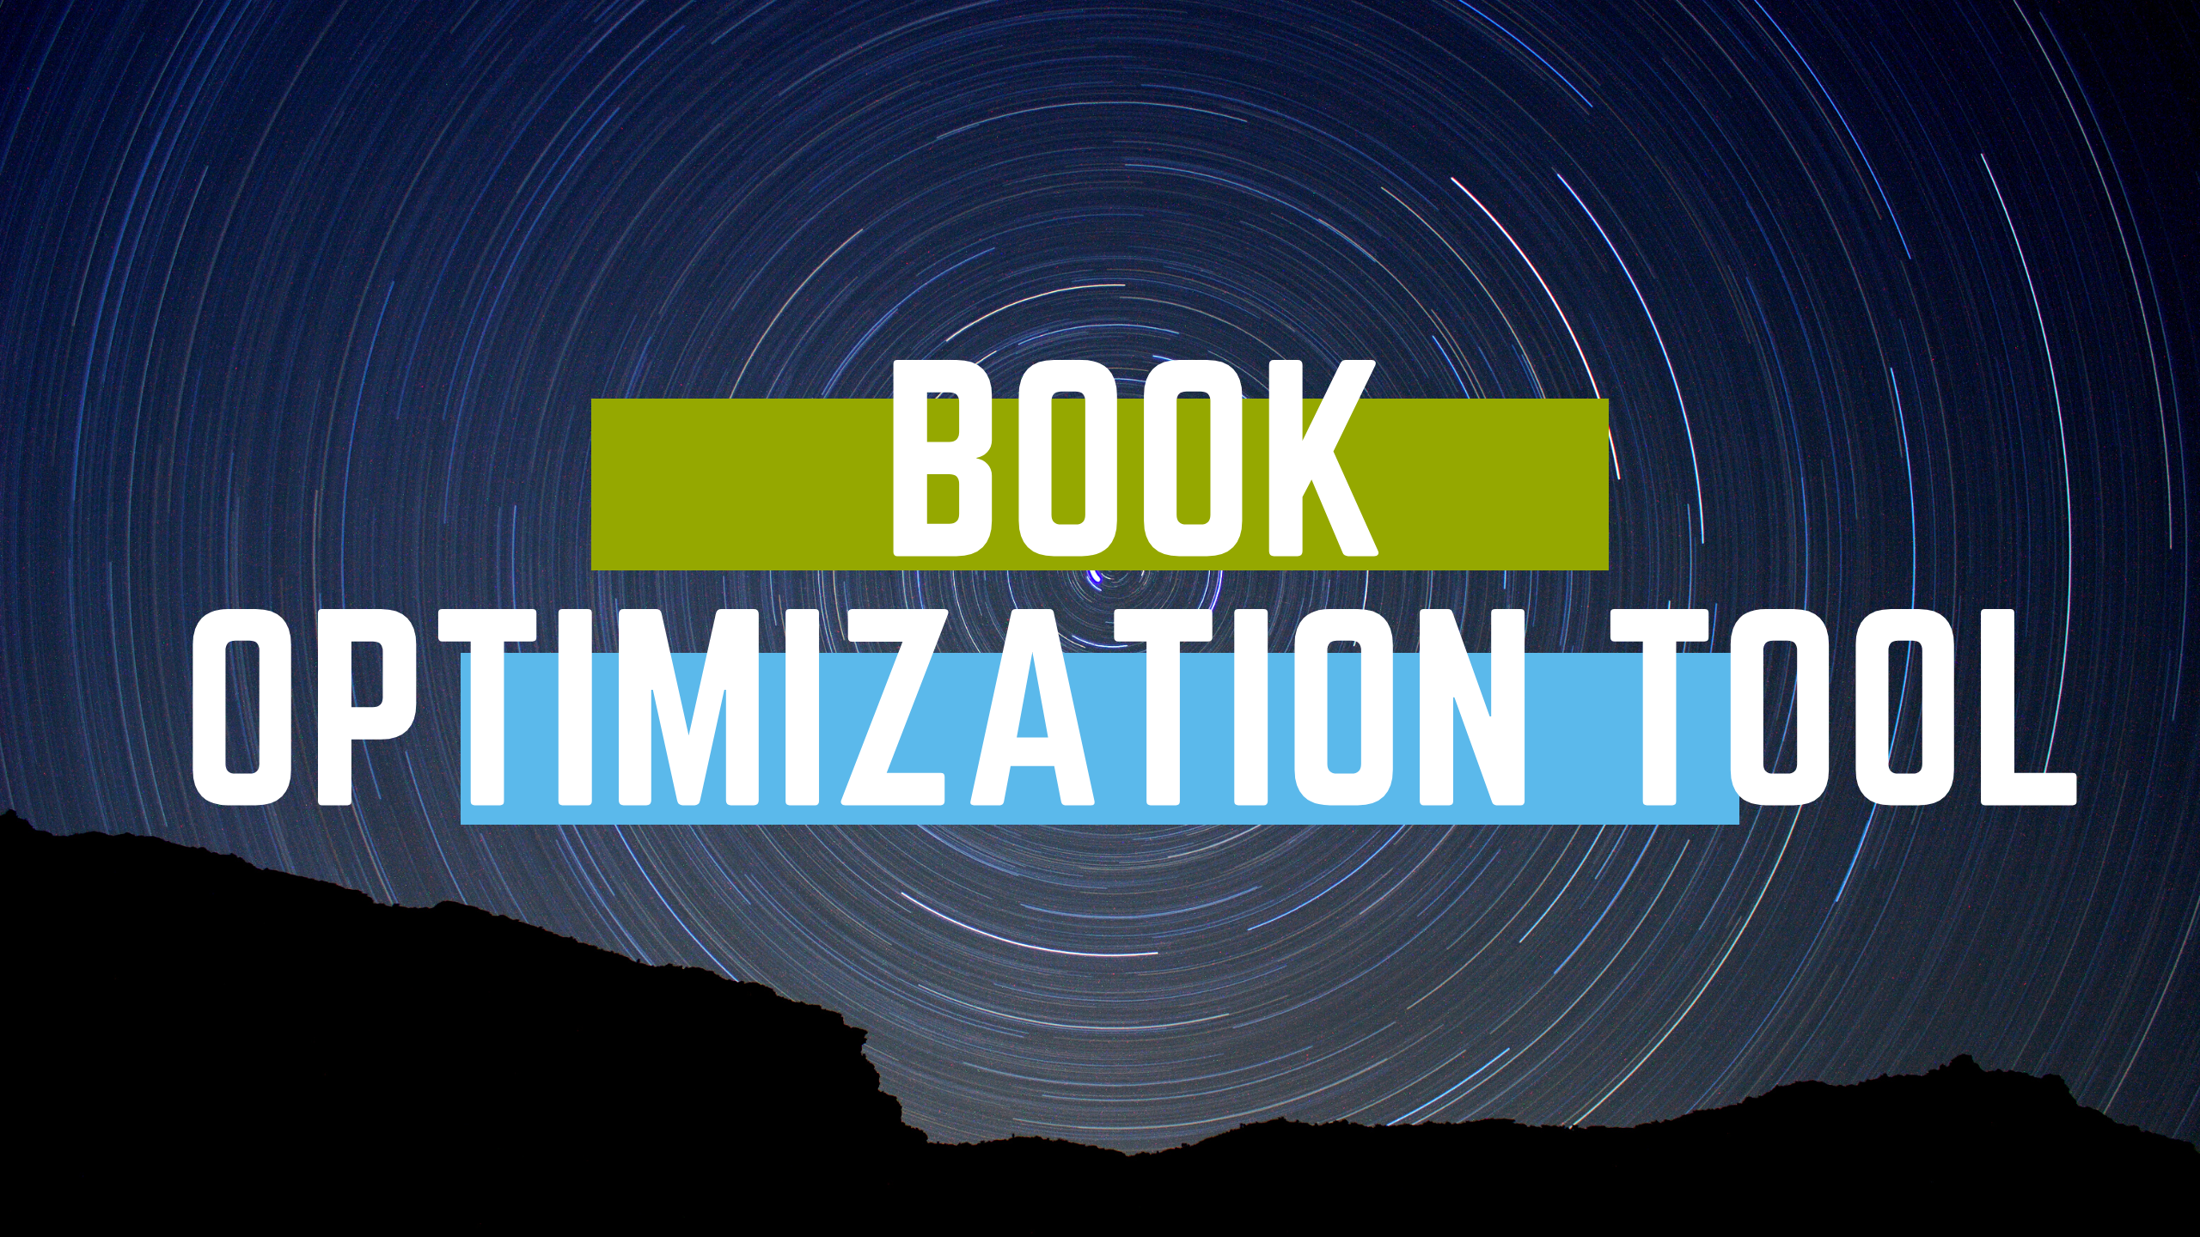

Slide 2
What is Book Optimization Tool
The Book Optimization Tool is to provide a platform where librarian and library’s executive members can manage their Library books with optimized way .
The application should be self-managed by the librarian and library’s executive members with least manual involvement .
This system will provide many management suggestion with optimal It should also be modular for future expansion. Following are the features/services that the system should provide .

Slide 3
Inputs
Book Information : There is a huge amount of books in this library . To maintenance , organize , sorting , searching there is some important parameter fixed for each books . They are:
Book Name
Writer Name
Book ID
Book Type
Priority
Borrow Count
Month Count
Price

Slide 4
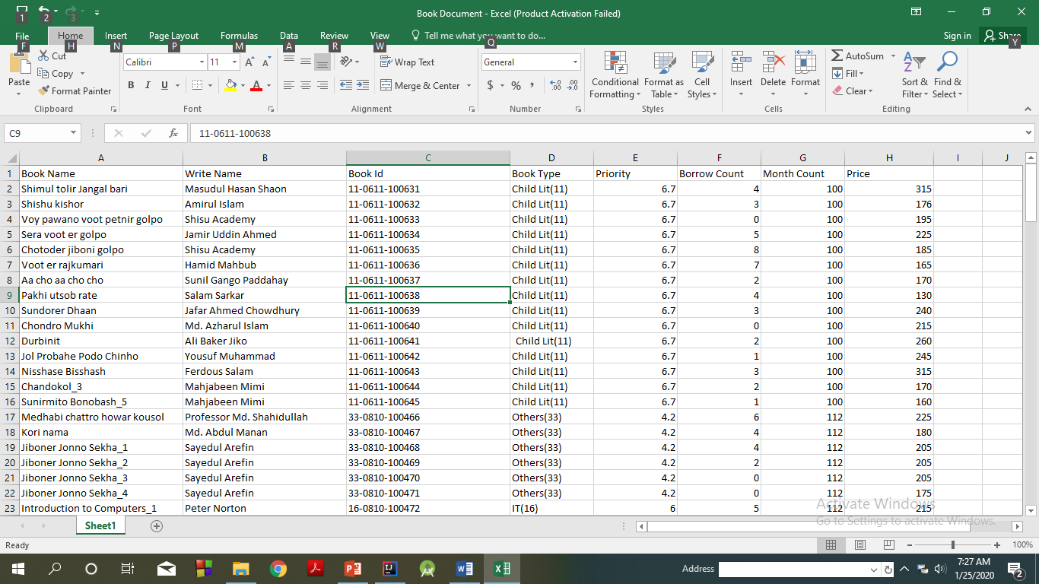

Slide 5
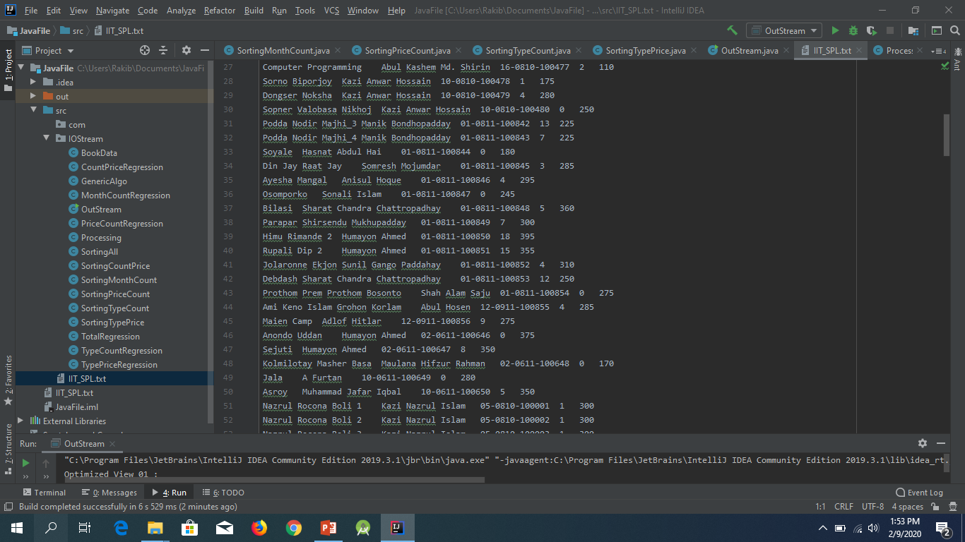
inputs

Slide 6
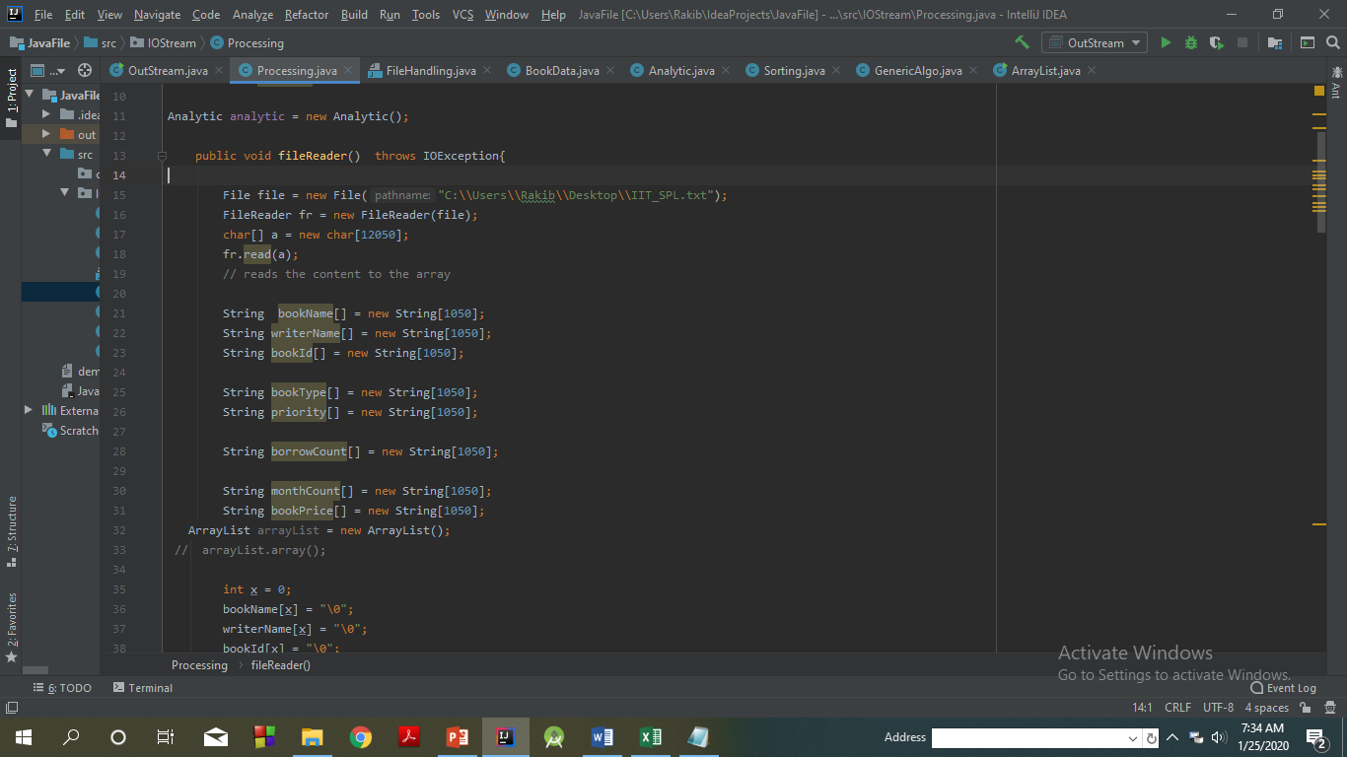
Store data in array

Slide 7
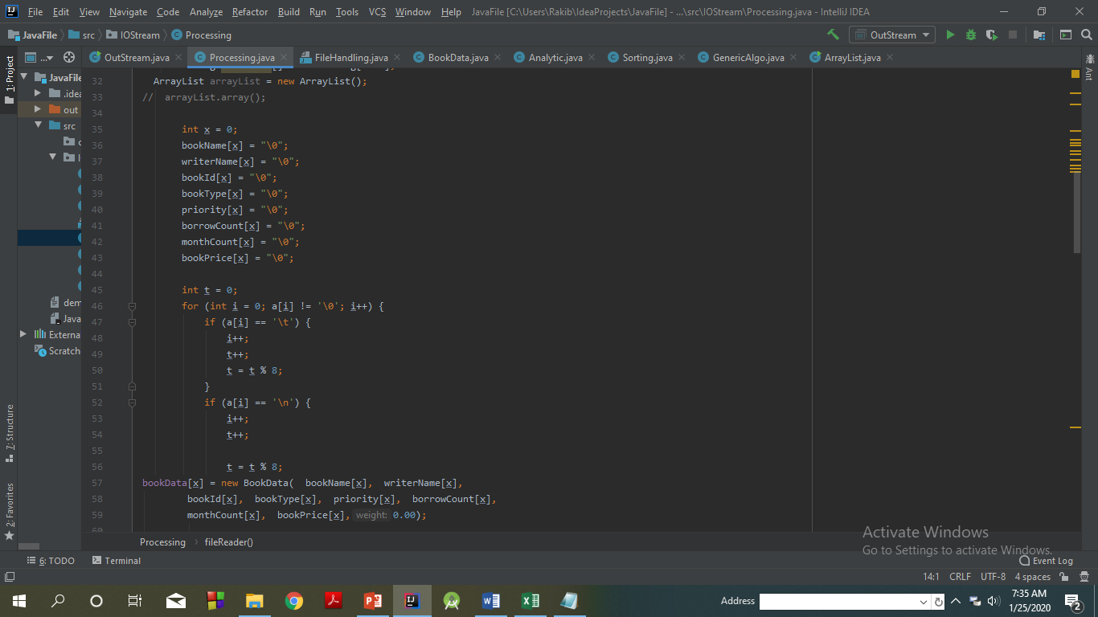
Store data in array

Slide 8
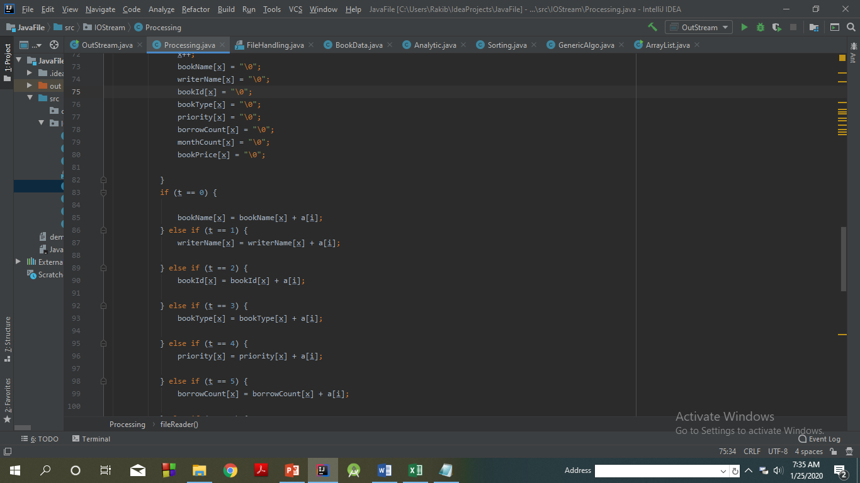

Slide 9
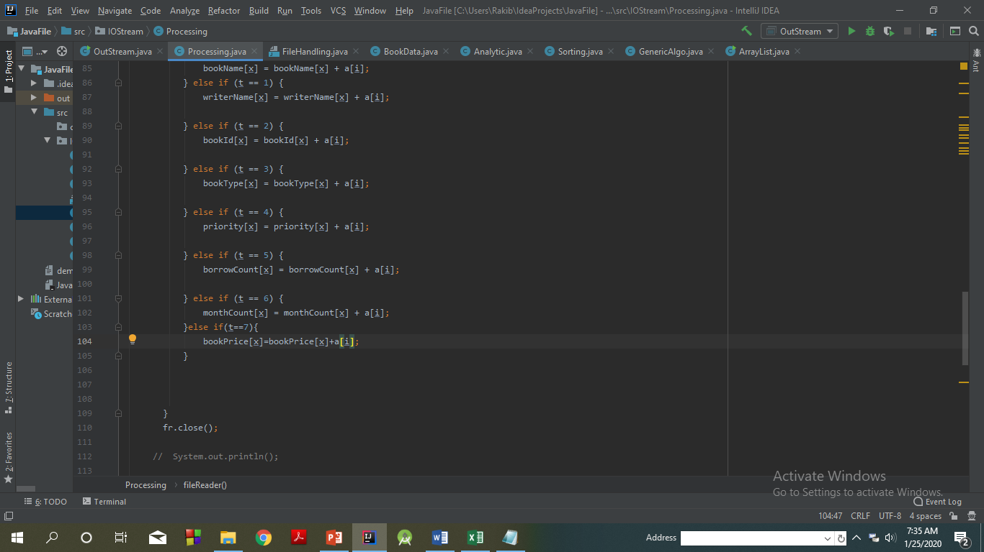

Slide 10
Book Remove Suggestion :
Book Remove Suggestion : In this part this system will give suggestions about which n number books should be remove which is calculated by each book weight . Weight is measured by each books different types of priority .

Slide 11
Priority Calculation :
Book Priority = 20 - sqrt(Book's Types Value)
Time Priority = 16 - (Time/12)
Borrow Count = Book Count
Serial Priority = qubicRoot(Serial No)
Writer Priority = Write Priority
Price Priority = pentaRoot(Book Price * Book Price)

Slide 12
Weight Calculation
Book Weight = Book Priority + Time Priority + Borrow
.
Count + Serial Priority + Writer Priority + Price Priority
.

Slide 13
Weight Calculation
Book Weight = 20 - sqrt(Book's Types Value) + 16 - (Time/12) + Book Count
.
+ qubicRoot(Serial No) + Write Priority +
pentaRoot(Book Price * Book Price )

Slide 14
Weight Calculation
Book Weight = 36 - sqrt(Book's Types Value) - (Time/12) + Book Count + QubicRoot(Serial No) +
.
Write Priority +
PentaRoot(Book Price * Book Price )
.

Slide 15
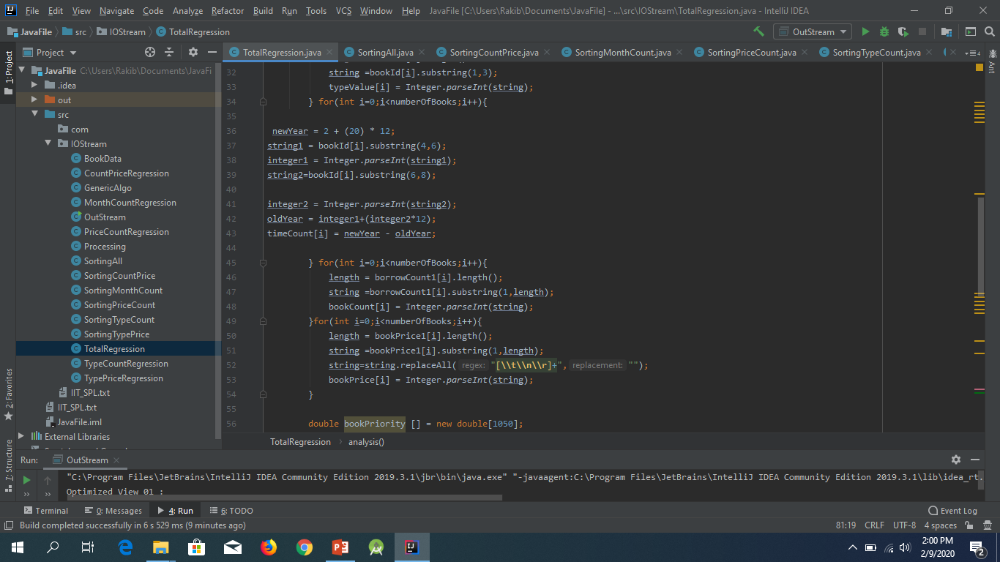

Slide 16
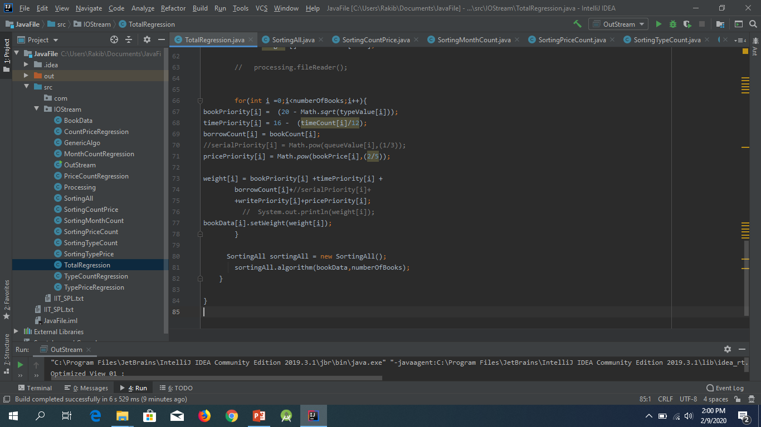

Slide 17
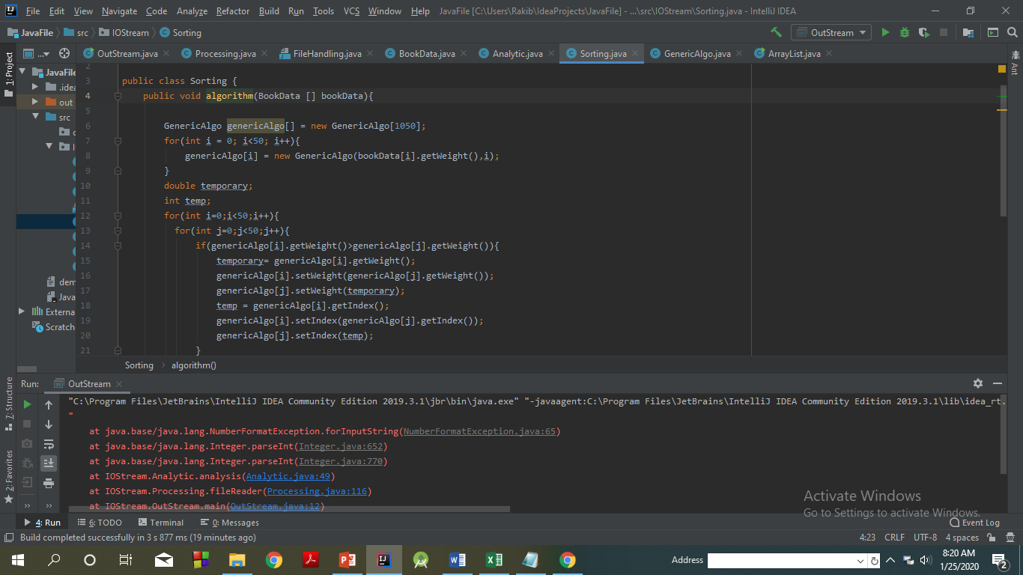

Slide 18
Linear Regression Based weight calculation
Here every parameter like book priority , book price , borrow count all are partially more or less related with each other .

Slide 19
Linear Regression Based weight calculation
So we will find how much relationship between each of the parameter .We will make linear regression on each of two parameter , find output and verify the relationship .

Slide 20
Types of regression we consider
1
Type
Count
2
Month
Regression
3
Price
Regression
Regression
Count
Count

Slide 21
Types of regression we consider
4
Count
Price
5
Type
Regression
Regression
Price

Slide 22
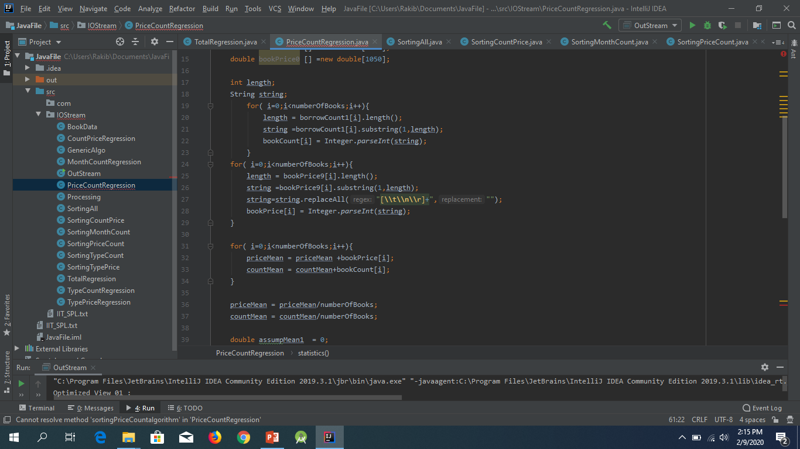
Price Count Regression

Slide 23
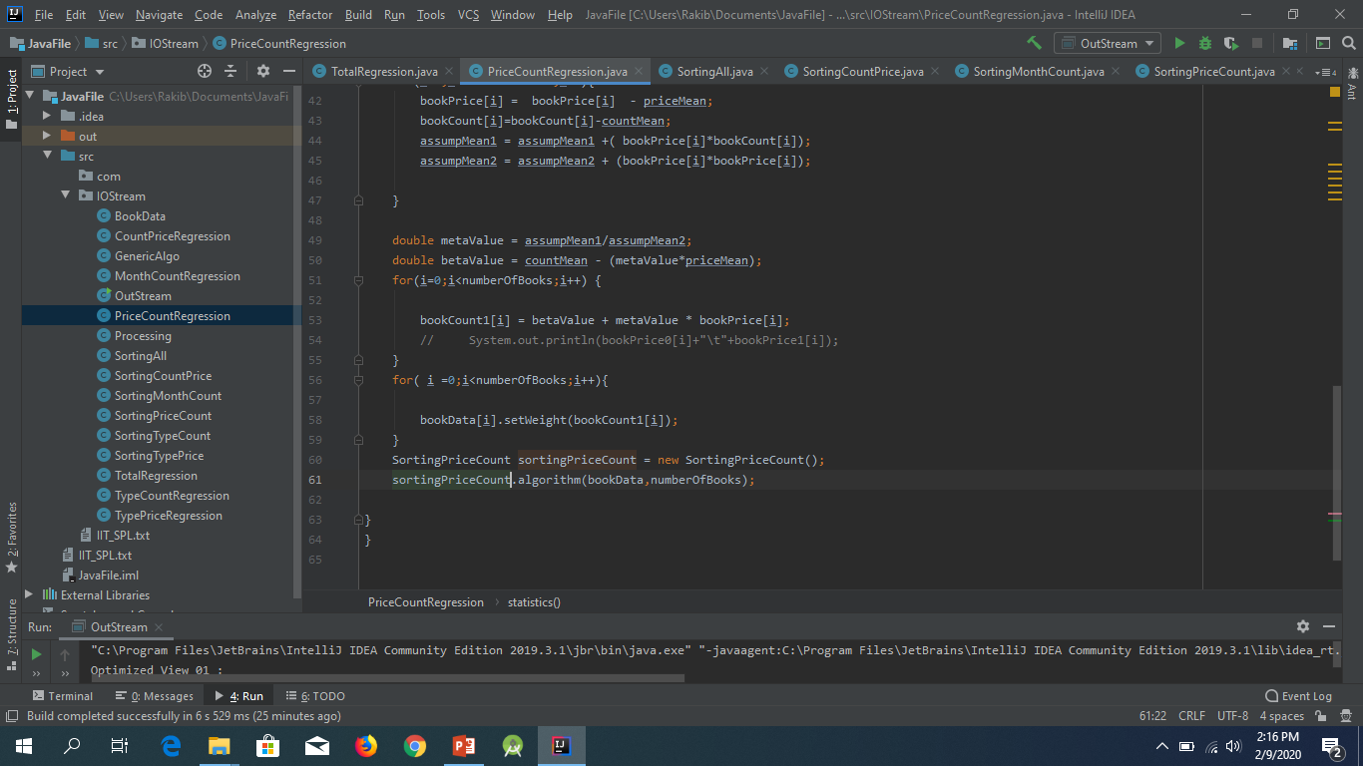
Price Count Regression

Slide 24
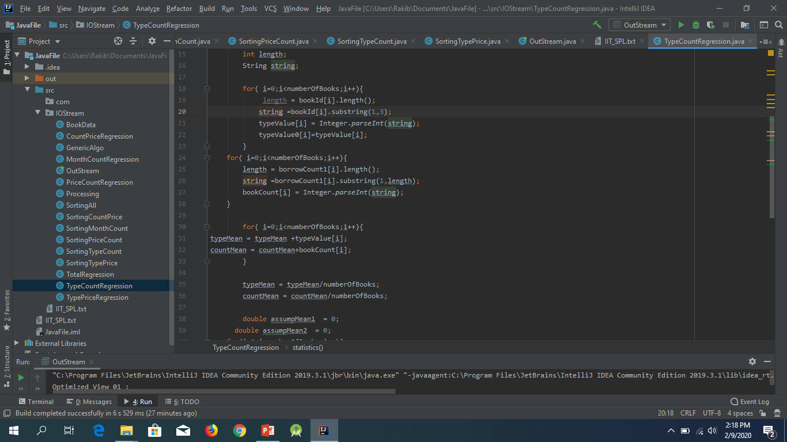
Type Count Regression

Slide 25
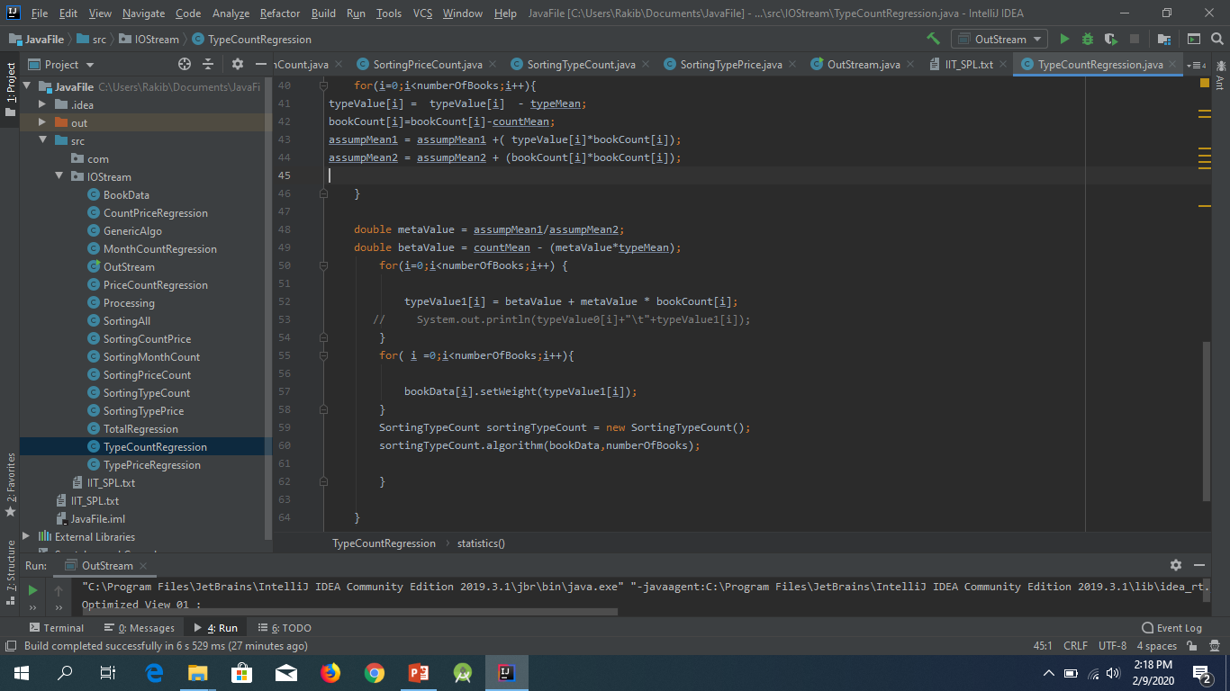
Type Count Regression

Slide 26


Slide 27
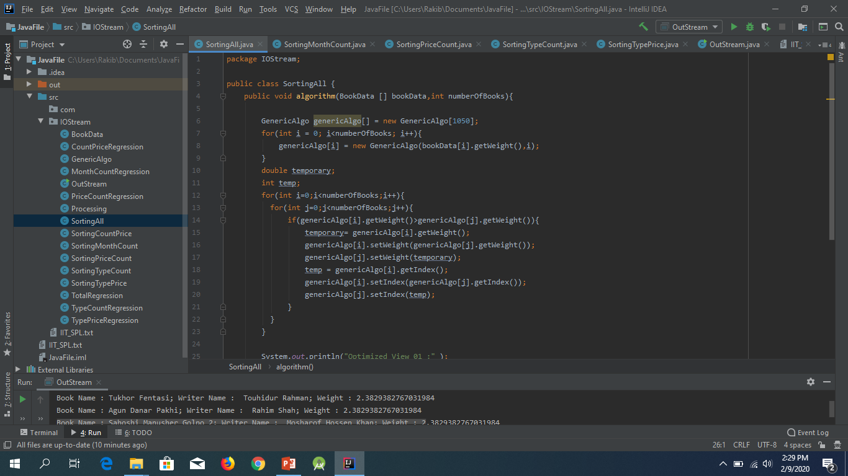
Sorting……….

Slide 28
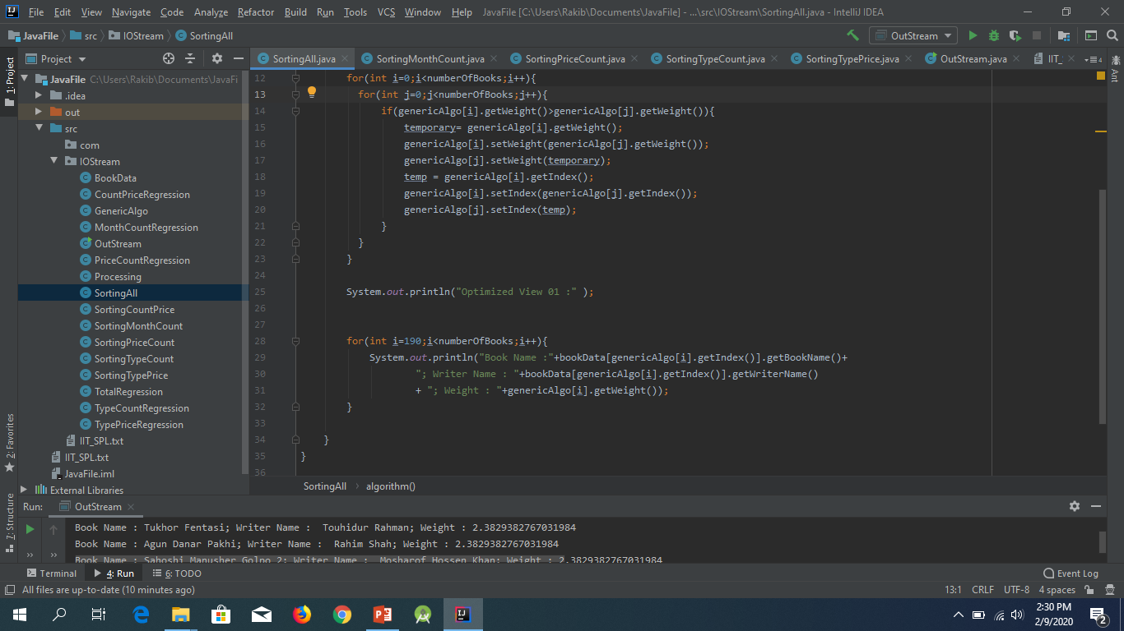
Sorting……….

Slide 29
Optimized View

Slide 30
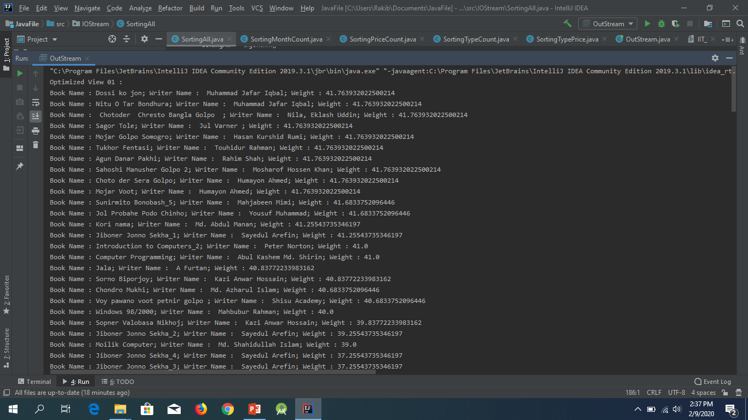
Optimized View 01

Slide 31
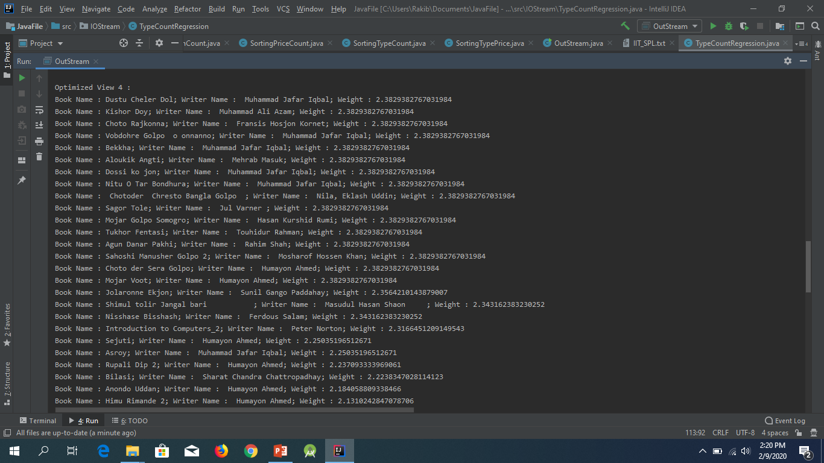
Optimized View 02

Slide 32
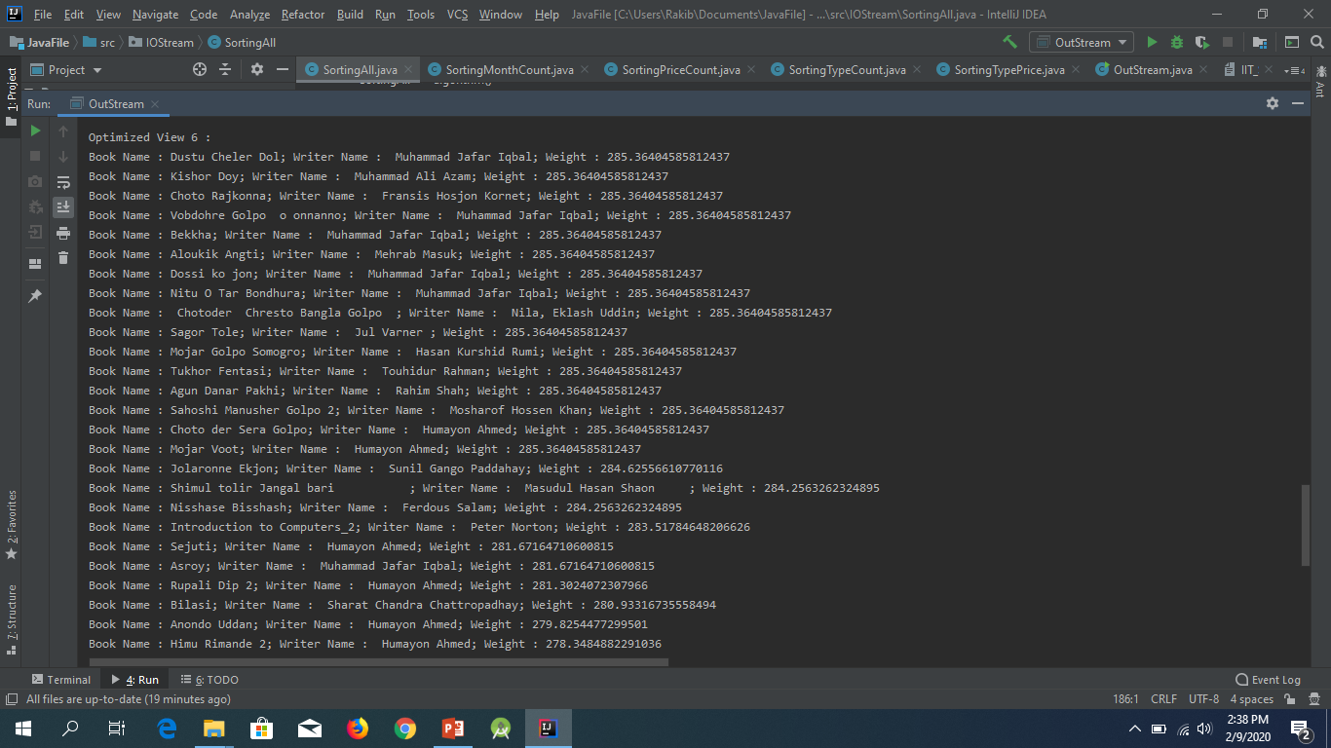
Optimized View 03

Slide 33
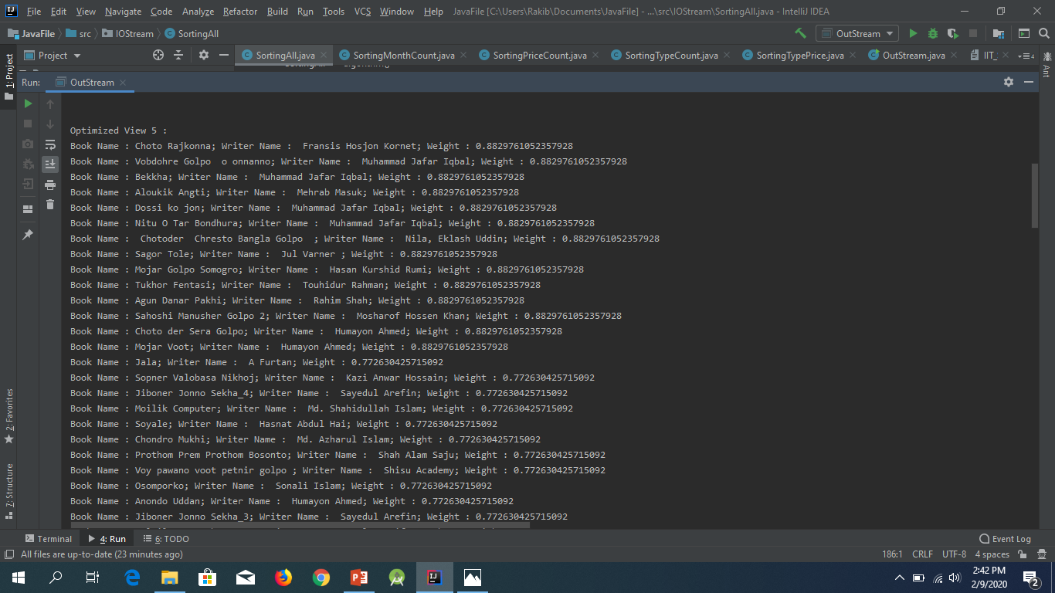
Optimized View 04

Slide 34
Next…..

Slide 35


